Slide 1
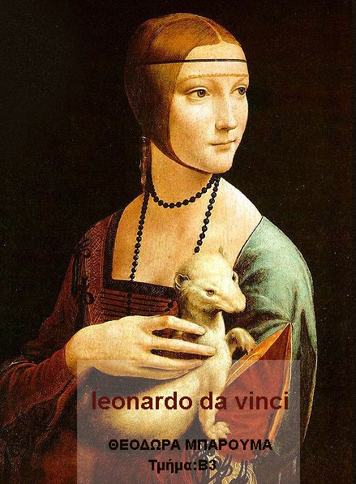

Slide 2
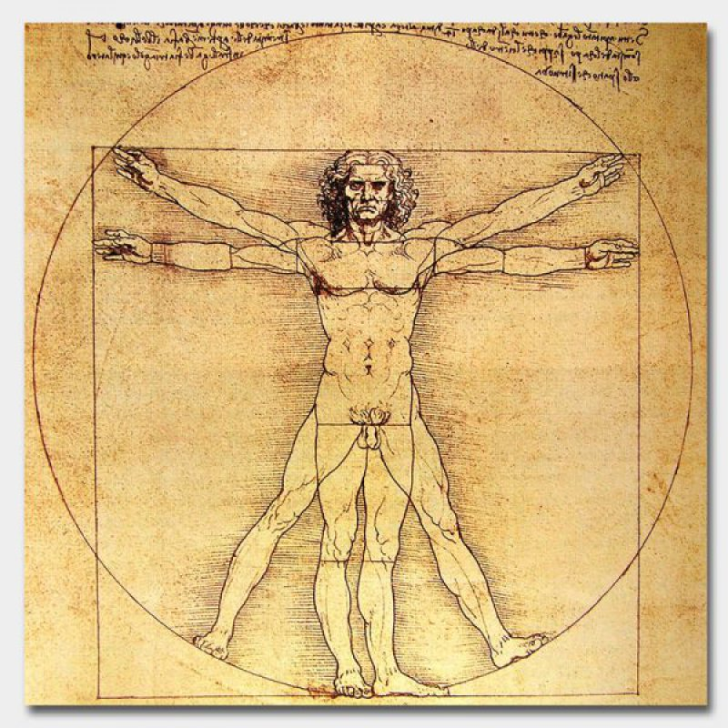
Who Was Leonardo da Vinci?
Leonardo da Vinci was a Renaissance painter, sculptor, architect, inventor, military engineer and draftsman — the epitome of a true Renaissance man. Gifted with a curious mind and a brilliant intellect, da Vinci studied the laws of science and nature, which greatly informed his work. His drawings, paintings and other works have influenced countless artists and engineers over the centuries.

Slide 3
Early Life
Da Vinci was born in a farmhouse outside the village of Anchiano in Tuscany, Italy (about 18 miles west of Florence) on April 15, 1452.
Born out of wedlock to respected Florentine notary Ser Piero and a young peasant woman named Caterina, da Vinci was raised by his father and his stepmother.
At the age of five, he moved to his father’s estate in nearby Vinci (the town from which his surname derives), where he lived with his uncle and grandparents.

Slide 4
What was Leonardo da Vinci’s personality like?
Leonardo da Vinci was described as having a gracious but reserved personality and an elegant bearing. He was known to be fastidious in personal care, keeping a beard neat and trim in later age, and to dress in colorful clothing in styles that dismissed current customs. The 16th-century writer Giorgio Vasari indicated that Leonardo cared little for money but was very generous toward his friends and assistants. He had an exceedingly inquisitive mind and made strenuous efforts to become erudite in languages, natural science, mathematics, philosophy, and history, among other subjects. The writings in his notebooks suggest that he may have been a vegetarian, and there is also some speculation that he may have been homosexual.

Slide 5
Education
Young da Vinci received little formal education beyond basic reading, writing and mathematics instruction, but his artistic talents were evident from an early age.
Around the age of 14, da Vinci began a lengthy apprenticeship with the noted artist Andrea del Verrocchio in Florence. He learned a wide breadth of technical skills including metalworking, leather arts, carpentry, drawing, painting and sculpting.
His earliest known dated work — a pen-and-ink drawing of a landscape in the Arno valley — was sketched in 1473.

Slide 6
Leonardo da Vinci: Early Career
Da Vinci received no formal education beyond basic reading, writing and math, but his father appreciated his artistic talent and apprenticed him at around age 15 to the noted sculptor and painter Andrea del Verrocchio, of Florence.
In 1478, after leaving del Verrocchio’s studio, da Vinci received his first independent commission for an altarpiece to reside in a chapel inside Florence’s Palazzo Vecchio.
Three years later the Augustinian monks of Florence’s San Donato a Scopeto tasked him to paint “Adoration of the Magi.” The young artist, however, would leave the city and abandon both commissions without ever completing them.

Slide 7
Famous Artworks by Leonardo da Vinci
He created innovative compositions, investigated anatomy to accurately represent the human body, considered the human psyche to illustrate character, and experimented with methods of representing space and three-dimensional objects on a two-dimensional surface. The result of his inexhaustible curiosity is many unfinished projects but also some of the most lifelike, complex, and tender representations of human nature. His experiments influenced the art of his successors and often became the standard of representation in subsequent centuries. At his death in 1519, Leonardo left many notebooks filled with jottings and sketches but very few finished works. Some of his pieces were completed by assistants, but others were lost, destroyed, or overpainted. Below are 10 examples of some of his most well-known surviving works.

Slide 8
Mona Lisa (c. 1503–19)

Slide 9
Leonardo da Vinci: Mona LisaMona Lisa, oil on wood panel by Leonardo da Vinci, c. 1503–19; in the Louvre, Paris.
© Everett-Art/Shutterstock.comThe world’s most famous artwork, the Mona Lisa draws thousands of visitors to the Louvre Museum each day, many of whom are compelled by the sitter’s mysterious gaze and enigmatic smile. The seemingly ordinary portrait of a young woman dressed modestly in a thin veil, somber colors, and no jewelry might also confound its viewers, who may wonder what all the fuss is about. The painting’s simplicity belies Leonardo’s talent for realism. The subject’s softly modeled face shows his skillful handling of sfumato, an artistic technique that uses subtle gradations of light and shadow, rather than line, to model form. The delicately painted veil, the finely wrought tresses, and the careful rendering of folded fabric reveal Leonardo’s tireless patience in recreating his studied observations. Moreover, the sitter’s perplexing expression only adds to her realism. Her smile might be engaging or it might be mocking—viewers can’t quite figure it out because, like a human, she is a complex figure, embodying contrary characteristics simultaneously.

Slide 10
The Annunciation
The subject matter is drawn from Luke 1.26-39 and depicts the angel Gabriel, sent by God to announce to a virgin, Mary, that she would miraculously conceive and give birth to a son, to be named Jesus, and to be called "the Son of God" whose reign would never end. The subject was very popular for artworks and had been depicted many times in the art of Florence, including several examples by the Early Renaissance painter Fra Angelico. The details of its commission and its early history remain obscure.^{[3]}
Oil and tempera on poplar panel 98 × 217 cm (38.25 × 84.62 in)
1472–1476

Slide 11
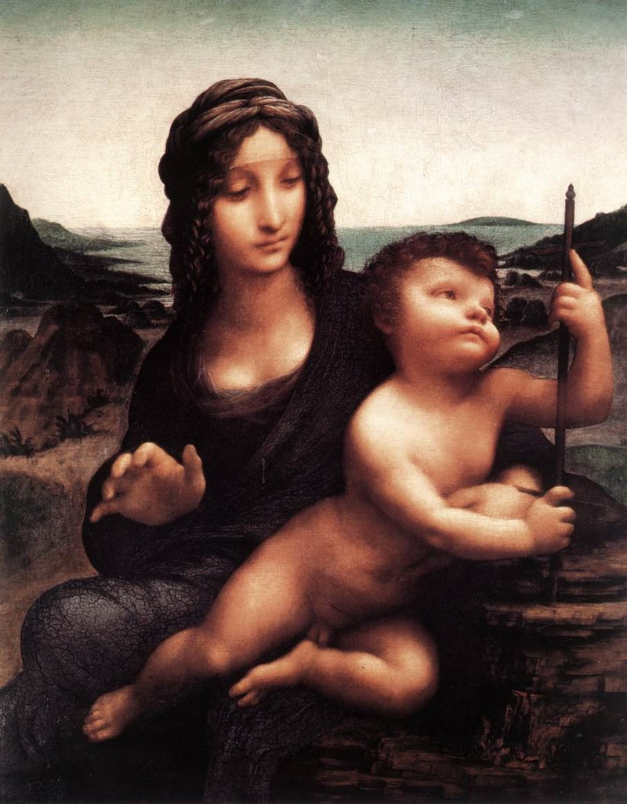
The Madonna of the
Yarnwinder
1499–1508
Painting Oil on walnut panel 48.9 × 36.8 cm
The Last Supper
1492–1498
Fresco Tempera on gesso, pitch and mastic 460 × 880 cm (181 × 346 in)

Slide 12
Vitruvian Man (c. 1490)
Leonardo da Vinci: Vitruvian ManVitruvian Man, drawing by Leonardo da Vinci, c. 1490; in the Gallerie dell'Accademia, Venice.
Creatas/Getty Images

Slide 13
Self Portrait (c. 1490/1515–16)
Leonardo da Vinci: self-portraitSelf-portrait, drawing by Leonardo da Vinci, c. 1490/1515–16; in the Royal Library, Turin, Italy.
Photos.com/Jupiterimages

Slide 14
Head of a Woman (1500–10)
Leonardo da Vinci: Head of a WomanHead of a Woman (also called La Scapigliata), oil, earth, and white lead pigments on poplar wood by Leonardo da Vinci, 1500–10; in the National Gallery, Parma, Italy.
© Alfredo Dagli Orti/REX/Shutterstock.com

Slide 15
Wikipedia
https://www.biography.com/artist/leonardo-da-vinci
Leonardo da Vinci: Art, Family & Facts - HISTORY
www.history.com › topics › renaissance
https://www.britannica.com/biography
Shutterstock.com

