Slide 1
LEONARDO DA VINCI
THROUGH MY EYES
By Elpida Tsiogka B5

Slide 2
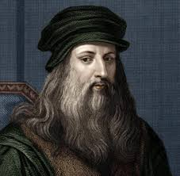
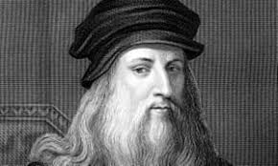
A FEW WORDS ABOYT HIS PERSONAL LIFE
Leonardo( di ser Piero) Da Vinci was born April 15, 1452, Anchiano near Vinci Republic of Florence ( Italy) and died May 2, 1519 Cloux (France). He applied his creativity to every realm in which graphic representation is used: he was a painter, sculptor, architect, and engineer. But he went even beyond that. He used his superb intellect and mastery of the art of drawing to study nature itself a line of inquiry that allowed his dual pursuits of art and science to flourish. Also some of the writings in his notebooks suggest that he may have been a vegetarian, and there is also some speculation that he may have been homosexual.
Leonardo’s parents were unmarried at the time of his birth. His father Ser Piero was a Florentine notary and landlord and his mother Caterina was a young peasant woman who shortly thereafter married an artisan. Leonardo grew up on his father’s family’s estateand received the usual elementary education of that day: reading, writing, and arithmetic. Leonardo did not seriously study Latin the key language of traditional learning, until much later when he acquired a working knowledge of it on his own. He also did not apply himself to higher mathematics advanced geometry and arithmetic until he was 30 years old when he began to study it with diligent tenacity.

Slide 3
Some information about Leonardo Da Vinci
When Leonardo was 24 he was accused of sodomising a 17-year-old boy. Leonardo was denounced in an anonymous letter which was passed on to the Florentine police. When no witnesses came forward to testify against him the charges were dropped. However Leonardo’s journals suggest that as a man who liked to keep his private life private he found the allegations devastating. He was an accomplished lyre player. When he was first presented at the Milanese court it was as a musician, not an artist or inventor.
There’s a reason da Vinci painted the human form so realistically: the artist obsessively studied human anatomy by dissecting human cadavers. In an era when medical knowledge in Europe was rudimentary to say the least Da Vinci was one of the original pioneers in the field of documenting the human anatomy. To this day he is considered one of the forefathers of the study.
Although Leonardo’s mind was extraordinarily fertile, he was also an inveterate procrastinator and even quitter. He frequently took months or years to begin work on commissions sometimes keeping patrons at bay with lofty pronouncements regarding his creative process.
A giant equestrian statue for the duke of Milan requiring 70 tons of bronze to cast might have been his grandest work if it had ever been completed. Yet a decade after the 1482 commission Leonardo had produced only a clay model which was subsequently destroyed when invading French soldiers used it for target practice.

Slide 4
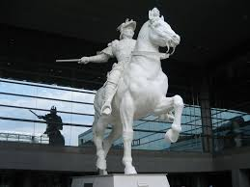
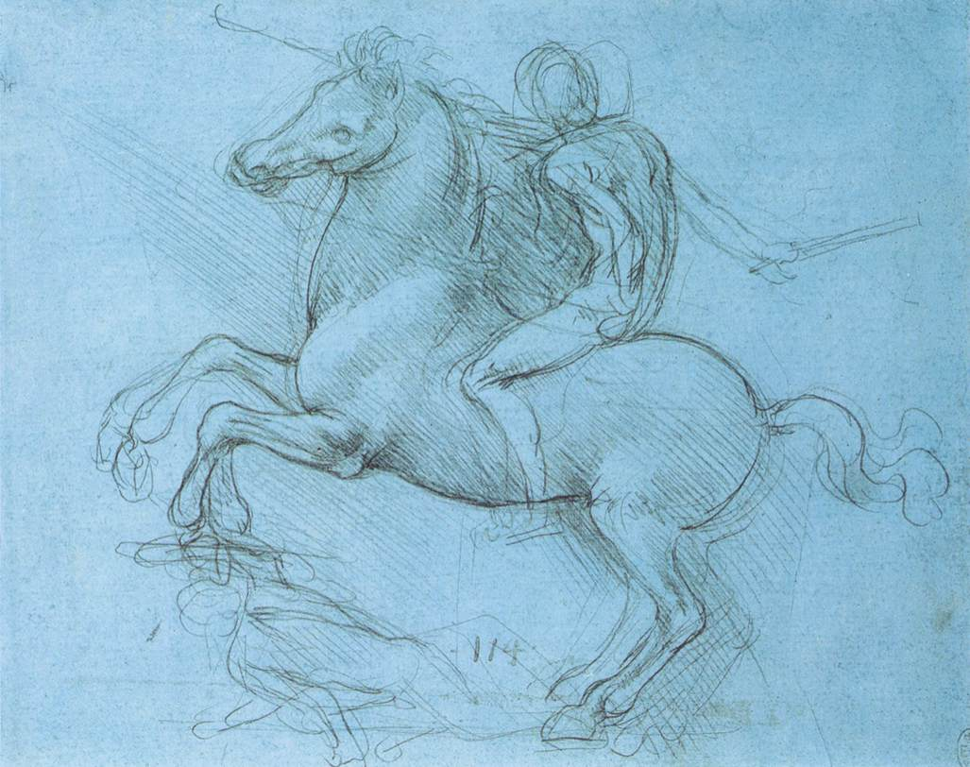
LIFE AND WORKS
Leonardo Da Vinci received no formal education beyond basic reading writing and math but his father appreciated his artistic talent and apprenticed him at around age 15 to the noted sculptor and painter Andrea del Verrocchio of Florence. For about a decade Da Vinci refined his painting and sculpting techniques and trained in mechanical arts. Around 1482 he began to paint his first commissioned work The Adoration of the Magi for Florence’s San Donato, a Scopeto monastery. However, Da Vinci never completed that piece because shortly thereafter he relocated to Milan to work for the ruling Sforza clan serving as an engineer, painter, architect designer of court festivals and most notably, a sculptor. The family asked Da Vinci to create a magnificent 16-foot-tall equestrian statue in bronze to honor dynasty founder Francesco Sforza.
Leonardo da Vinci's total output in painting is really rather small there are less than 20 surviving paintings that can be definitely attributed to him and several of them are unfinished. Two of his most important works the Battle of Anghiari and the Leda neither of them completed have survived only in copies.

Slide 5
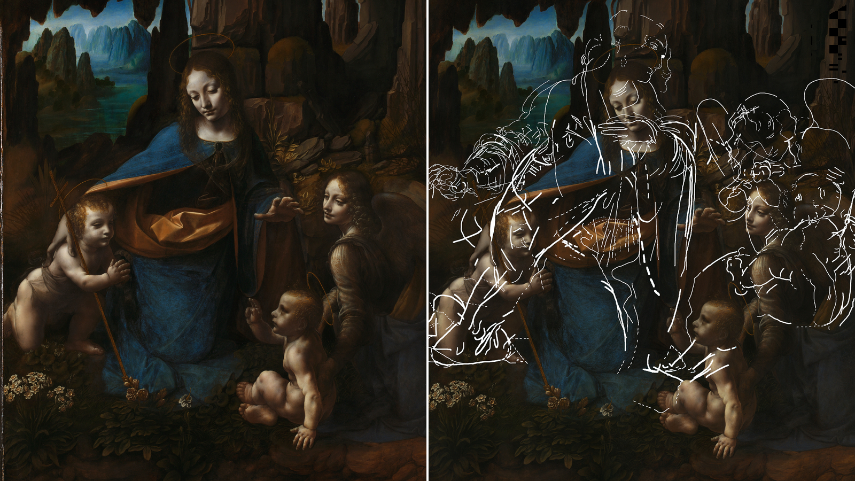
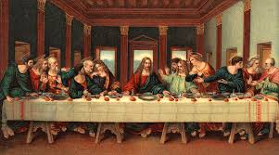
HIS PAINTINGS AND DRAWINGS
As a painter Leonardo completed six works in the 17 years in Milan. From about 1483 to 1486 he worked on the altar painting THE Virgin of the Rocks, a project that led to 10 years of litigation between the Confraternity of the Immaculate Conception which commissioned it and Leonardo for uncertain purposes this legal dispute led Leonardo to create another version of the work in about 1508. During this first Milanese period he also made one of his most famous works the monumental wall painting Last Supper (1495–98) in the refectory of the monastery of Santa Maria delle Grazie

Slide 6
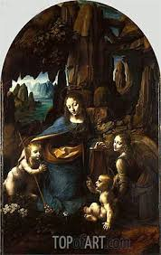
THE VIRGIN OF THE ROCKS
The Virgin of the Rocks in its first version (1483–86) is the work that reveals Leonardo's painting at its purest. It depicts the apocryphal legend of the meeting in the wilderness between the young John the Baptist and Jesus returning home from Egypt. It was claimed that when King Herod ordered the Massacre of the Innocents the Holy Family fled to Egypt and on their way met Saint John who also escaped the massacre. The Virgin of the Rocks demonstrates Leonardo's revolutionary technique of using shadows, rather than outlines, to model his figures. The Virgin of the Rocks was duly completed by about 1484, and may have been installed in the chapel of the Immaculate Conception, as intended. However, within a short time it was sold for 100 ducats to King Louis XII of France who may have then presented it to the Holy Roman Emperor Maximilian I
The commission for this altarpiece art was awarded to Leonardo on the basis that he portrayed the Virgin in honour of the doctrine of the Immaculate Conception the dogma proclaiming Mary was conceived without original sin. As the name indicates the iconographical setting is a rocky grotto, where four figures are sitting together on the stone floor in a pyramid-like arrangement which seemingly holds all four figures in a tight exchange of looks and gestures. To the right the Archangel Gabriel welcomes us to the scene with an enigmatic gaze whilst pointing to the child figure of Saint John. With his other hand he supports the Christ Child sitting next to him. At the apex of the pyramid sits the Virgin or Madonna whose hand is raised, palm-down, over the head of the infant Christ as if giving him a blessing. Gabriel's hand which is pointing to the infant John, forms a horizontal line in the space between the Virgin's hand and the head of Christ as if completing an invisible cross. Meanwhile the Christ Child tiny right arm is raised in a gesture of benediction aimed at the infant Saint John who clasps his hands in prayer.

Slide 7
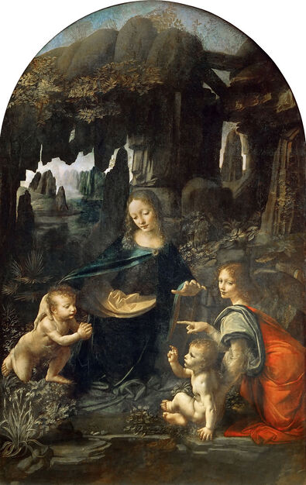
What the painting depicts on my part
Leonardo was very aware of Christian symbolism and according to a couple of sources, rocks also represent "The Lord his solidity, firmness and strength“ .The angel points at Jesus as he looks at John the Baptist. Perhaps he is indicating the protective relationship that John would share with Jesus . As for the direction of the gaze and the mysterious expression of the angel I can only speculate. Some say that the angel looks at Jesus. At least that this was Da Vinci's intention. It is hard to believe that Da Vinci could not paint this properly but he was still young when he made this painting so i cannot completely exclude this or perhaps the angel is staring at the viewer to make us part of the painting

Slide 8
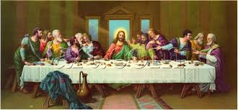
THE LAST SUPPER
Last Supper, Italian Cenacolo one of the most famous artworks in the world, painted by Leonardo Da Vinci probably between 1495 and 1498 for the Dominican monastery Santa Maria delle Grazie in Milan. It depicts the dramatic scene described in several closely connected moments in the Gospels, in which Jesus declares that one of the Apostles will betray him and later institutes the Eucharist. According to Leonardo’s belief that posture, gesture, and expression should manifest the “notions of the mind,” each one of the 12 disciples reacts in a manner that Leonardo considered fit for that man’s personality. The result is a complex study of varied human emotion, rendered in a deceptively simple composition. The subject of the Last Supper was a popular choice for the refectory walls of monasteries and convents in 15th century Italy whereby nuns and monks could have their meals in the presence of Jesus’ final repast. Leonardo’s version appears neatly arranged, with Jesus at the centre of an extensive table and the Apostles to his left and right. He wears the traditional red and blue robes and has a beard, but Leonardo did not imbue him with the customary halo

Slide 9
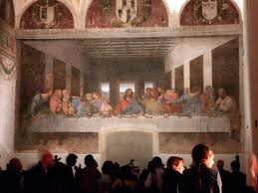
The last supper
. Some scholars have proposed that the light from the window behind him serves this role or that the implied lines of the pediment above the window create the illusion of a halo. Other scholars have argued that the missing attribute may also suggest that Jesus is still a human being who as such will endure the pain and suffering of the Passion. The scene is not a frozen moment but rather a representation of successive moments. Jesus has declared his forthcoming betrayal, and the Apostles react. Philip who stands in the group to Jesus’ left gestures toward himself and seems to say, “Surely not I, Lord?” Jesus seems to reply “The one who has dipped his hand into the bowl with me will betray me”. Simultaneously, Jesus and Judas, who sits with the group to Jesus’ right, reach toward the same dish on the table between them, an act that marks Judas as the betrayer. Jesus also gestures toward a glass of wine and a piece of bread, suggesting the establishment of the Holy Communion rite.
When the project was given to him, Leonardo da Vinci was new to painting frescos This was the largest work that he had attempted to that point. Leonardo’s work is actually not a fresco, however. Knowing he needed time to work on the painting, he decided to experiment with beautiful pigments directly on the established plaster.
Two other almost exact replicas exist of The Last Supper. Believed to be painted by Leonardo’s assistants, the copies are both in well-preserved states. Perhaps they chose to recreate the piece as a true fresco? One is held in the Royal Academy of Arts in London and the other decorates the Church of St. Ambrogio in Ponte Capriasca, Switzerland. It is these copies that give us an idea of what da Vinci’s masterpiece would have looked like had it survived in better condition.

Slide 10
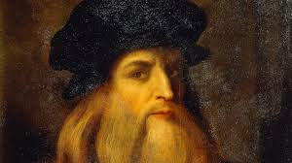
My opinion about Leonardo Da Vinci
All artists have their ways and their techniques . Leonardo da Vinci is easily recognized as one of the greatest painters the world has ever known . He was the most genius of all time .His ways and his techniques were recognized. Painting was really just one of Leonardo’s pastimes. Leonardo Da Vinci never used intense or bold colors or tints in contrasting colors but he used natural hues that were muted in intensity. Leonardo Da Vinci was a genius and so very knowledgeable and used to hard work and working with his hands. He is among the greatest painters in history and, some claim, the most gifted person the world has ever known.

Slide 11
BIBLIOGRAPHIC REPORT
Leonardo da Vinci Biography - life, family, childhood ... (notablebiographies.com)
Leonardo da Vinci | Biography, Paintings, Drawings ... (britannica.com)
Leonardo da Vinci: Facts & Biography | Live Science

