Slide 1
Existentialist Philosophers
Elsa M.
HELIOS TEAM

Slide 2
Existentialism is a form of philosophical inquiry that explores the problem of human existence and centers on the lived experience of the thinking, feeling, acting individual. Existentialism is associated with several 19th- and 20th-century European philosophers who shared an emphasis on the human subject, despite profound doctrinal differences. Many existentialists regarded traditional systematic or academic philosophies, in style and content, as too abstract and remote from concrete human experience.

Slide 3
Soren Kierkegaard
He is known as the “Father of Existentialism”. He was born in Denmark in 1813.
He believed that church congregations had no purpose, that Christendom was too political, and that Christianity was becoming an empty religion.
He stressed importance of the individual and is credited with creating the ideas of “subjectivity” and the “leap of faith”.
He wrote The Concept of Irony. From the Papers of One Still Living, and Fear and Trembling, among other works.

Slide 4
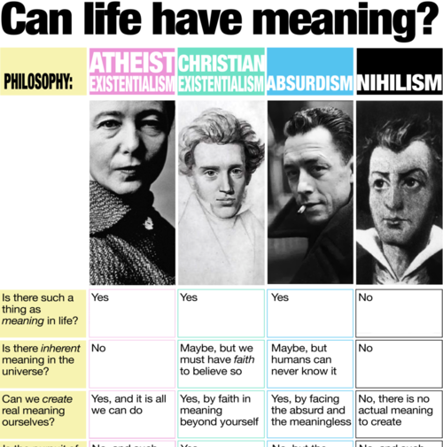

Slide 5
Jean-paul sartre
Jean-Paul Sartre was born on 21 June 1905 in Paris as the only child of Jean-Baptiste Sartre, an officer of the French Navy, and Anne-Marie (Schweitzer).
He is commonly considered the father of Existentialist philosophy, whose writings set the tone for intellectual life in the decade immediately following the Second World War.
Among the many ironies that permeate his life, not the least is the immense popularity of his scandalous public lecture “Existentialism is a Humanism”. He wrote Being and Nothingness, Existentialism is a Humanism, The Flies, No Exit, The Roads to Freedom, and Les Mots.

Slide 6
Albert Camus
He was born on November 7, 1913 and is often associated with Existentialism.
He claimed that while he did not believe in God, he was not an atheist.
He was a human rights activist in the 1950s.
He strongly opposed capital punishment.
He wrote The Stranger, The Myth of Sisyphus, The Plague and The Fall.

Slide 7
Nietzsche
Born in Germany, on 15 October 1844 – 25 August 1900) was a German philosopher, cultural critic, composer, poet, and philologist whose work has exerted a profound influence on modern intellectual history.He began his career as a classical philologist before turning to philosophy.
Nietzsche sees a complicity between morality and the Christian God that perpetuates a life-denying, and so ultimately nihilistic, stance. Nietzsche was not the first to de-couple morality from its divine sanction; psychological theories of the moral sentiments. He wrote The Birth of Tragedy, Untimely Meditations, On Truth and Lies in a Nonmoral Sense, All Too Human, and Beyond Good and Evil.

Slide 8
Simone de Beauvoir
She was born on January 9, 1908 and was associated with ideas of ambiguity, feminist ethics, existential feminism, the idea that “existence precedes essence,” and that a person is not born a woman, but becomes one.
She was active in France’s women’s liberation movement.
She wrote She Came to Stay, The Blood of Others, All Men Are Mortal and The Ethics of Ambiguity.

Slide 10
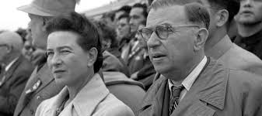

Slide 11
Writers and artists
Dostoevsky, Ibsen, and Kafka were conscripted and linked under the term Existentialism; in Paris there were Jean Genet, André Gide, André Malraux, and the expatriate Samuel Beckett; the Norwegian Knut Hamsun and the Romanian Eugene Ionesco belong to the club; artists such as Alberto Giacometti and even Abstract Expressionists such as Jackson Pollock, Arshile Gorky, and Willem de Kooning, and filmmakers such as Jean-Luc Godard and Ingmar Bergman were understood in existential terms. By the mid 1970s the cultural image of existentialism had become a cliché, parodized in countless books and films by Woody Allen.

Slide 12
Video

